Slide 1
VENDOR SECURITY RISK ASSESSMENT
PRESENTATION BY
LAWRENCE OBI

Slide 2
INTRODUCTION
Welcome to my presentation
Your comfort
Asking Questions

Slide 3
WHAT WILL I COVER DURING THIS PRESENTATION
Theoretical overview of concepts and steps dealing with a Third-party post data breach.
Factors leading to a breach
Post-Breach Risk Assessment / Remediation Best Practices
Contractual Implications / Recommendations
Case Study – Equifax 2017 Data Breach

Slide 4
Scenario - Introduction
XYZ Corporation relies heavily on third-party vendors for critical services and products, ensuring their security through thorough risk assessments. As we consider a potential partnership with ABC Solutions Inc., a leading cloud storage provider, a recent data breach at their client raises concerns. This presentation dissects the incident, assesses the current security posture, and outlines recommendations for both ABC Solutions Inc. and XYZ Corporation.

Slide 5
Causes of Data Breach
DATA BREACH
Human Factors
Phishing Attacks
Weak Passwords
Insider Threats
Social Engineering
Poor Employee Training
Technical Vulnerabilities
Malware & Ransomware
Unpatched Software
Inadequate Encryption
Physical Security and External Risks
Stolen or Lost Devices
Physical Security Lapses
Third-Party Vulnerabilities
Web Application Vulnerabilities
Inadequate Monitoring and Logging

Slide 6
Gather Information Request a detailed report from ABC Solutions Inc. regarding the data breach:
Specific data types affected Attack vectors and exploited vulnerabilities Timeline of the incident Root cause analysis findings (RCA) Response measures taken Remediation steps implemented Research industry best practices for cloud security | Review ABC Solutions Inc.'s security policies and procedures: Access controls Data encryption Vulnerability management Security awareness training Incident response plan Relevant standards and frameworks (NIST, ISO 27001)

Slide 7
Conduct the Security Risk Assessment Root Cause Analysis:
Evaluate the findings of ABC Solutions Inc.'s internal investigation into the breach.
Identify the underlying security weaknesses that allowed the attack to succeed
Assess the adequacy of existing security controls and procedures in preventing similar incidents.

Slide 8
Conduct the Security Risk Assessment Remediation Steps:
Analyze the implemented remedial measures taken by ABC Solutions Inc. to address the vulnerabilities exploited in the breach.
Evaluate the effectiveness of these measures in closing security gaps and preventing future attacks.
Assess the timeline for implementing additional planned remediation steps.

Slide 9
Preventive Measures for XYZ Corporation
Technical Controls
Multi-factor authentication
Data encryption (at rest and in transit)
Vulnerability Assessments &
Penetration Testing
Access Control
Logging & Monitoring

Slide 10
Preventive Measures for XYZ Corporation
Operational Controls
Regular Security Audits
Incident Response Plan Testing
Security Awareness Training

Slide 11
Preventive Measures for XYZ Corporation
Data Handling Practices
Data Segregation & Isolation
Data Ownership & Access Rights
Data deletion & Disposal Procedures

Slide 12
Potential risks to XYZ Corporation's data and systems
Data Exposure
Third-Party Vendor Risk
Reputation Damage
Financial Losses
Supply Chain Disruption
Regulatory Compliance Concerns
Business Continuity Risks
Legal Consequences
Loss of Competitive Advantage

Slide 13
Evaluating the security posture of ABC Solutions Inc.
SOC 2 Type 2 Penetration Testing Report Vulnerability Assessment Report Incident Response Plan Review Security Compliance Reports Business Continuity and Disaster Recovery Plans | Internal and External Audit Reports Contractual Obligations and SLA Compliance Reports Data Flow and Mapping Reports Employee Training and Awareness Reports Insurance Assessments

Slide 14
Contractual Implications AND RECOMMENDATIONS
Recommend including data security breach notification clauses in the contract, outlining specific communication protocols and timelines in case of incidents.
Include clear liability and indemnification clauses to protect XYZ Corporation in case of data breaches caused by ABC Solutions Inc.'s negligence.
Negotiate contractual provisions for suspension or termination of the partnership in case of repeated security failures or non-compliance with agreed-upon security measures.

Slide 15
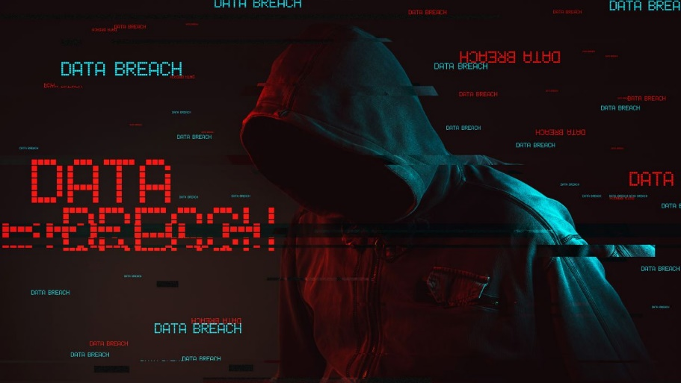
CASE STUDY - Equifax 2017 Data Breach

Slide 16
Deep Dive: Analyzing the Risks and Opportunities of Partnering with Equifax Post-2017 Data Breach
Summary:
The 2017 Equifax data breach remains a defining incident in consumer data security history. For XYZ Corporation, considering a partnership with Equifax raises critical questions about potential risks and opportunities. This report offers a deep dive into this complex scenario, analyzing the technical vulnerabilities, reputational implications, financial burdens, legal consequences, and contractual considerations to help XYZ Corporation make informed decisions.

Slide 17
Incident Details
Date:
Discovered on July 29, 2017; Publicly disclosed on September 7, 2017.
Affected individuals:
147 million Americans (roughly half the U.S. population).
Data exposed:
Names, Social Security numbers, birth dates, addresses, driver's license numbers, and credit card numbers (for some individuals).
Duration of breach:
March to July 2017 (approximately 4 months).

Slide 18
Timeline of Events
March 2017
Attackers exploit a known vulnerability (CVE-2017-5638) in Apache Struts, a widely used web application framework.
May-July 2017
Hackers infiltrate Equifax's systems and access sensitive personal data.
Data exfiltration continues for months without detection.
July 29, 2017
Equifax discovers the breach but does not immediately disclose it publicly.
September 7, 2017
Equifax publicly announces the data breach, revealing its extensive scope and potential impact.

Slide 19
Root Cause Analysis
Unpatched Apache Struts Vulnerability:
The attackers exploited a known vulnerability (CVE-2017-5638) in the Apache Struts web application framework used by Equifax.
Equifax failed to patch the vulnerability despite a patch being available for two months.
Inadequate Security Practices:
Weak password security: Accessible administrator accounts with default or easily guessable passwords.
Lack of network segmentation: Attackers easily moved between internal systems once inside.
Insufficient logging and monitoring: Delay in detecting the breach.
Inadequate incident response: Slow response and communication to affected individuals.

Slide 20
Root Cause Analysis
Human Error:
Failure to implement patches promptly.
Misconfiguration of security tools.
Inadequate training and awareness of security risks among employees.
Additional Contributing Factors:
Outdated IT infrastructure: Reliance on legacy systems with known vulnerabilities.
Decentralized IT management: Lack of cohesive security strategy and oversight.
Insufficient focus on cybersecurity: Prioritization of business operations over security investments.

Slide 21
Impact
Data Compromised:
Names
Number of People Affected:
Approximately 147 million Americans, 15.2 million British citizens, and 19,000 Canadians.
Social Security numbers
Addresses
Driver's licenses
Credit card numbers

Slide 22
Impact
Financial Fallout:
$575 million in fines and settlements, legal fees, and increased cybersecurity expenses.
Reputational Damage:
Loss of consumer trust, brand value erosion, and negative media coverage.
Leadership Change:
CEO resignation in the wake of the scandal.

Slide 23
Impact
Consequences:
Widespread identity theft and fraud.
Damage to Equifax's reputation and financial losses.
Regulatory fines and settlements.
Increased public scrutiny of cybersecurity practices in the credit reporting industry.
Response & Aftermath:
Equifax offered free credit monitoring and identity theft protection services to affected individuals.
Multiple investigations and lawsuits were launched.
Equifax implemented new security measures, but continues to face criticism for its handling of the breach.
The incident serves as a catalyst for broader discussions about data privacy and cybersecurity regulations.

Slide 24
Impact
Lessons Learned:
Importance of timely patching of known vulnerabilities.
Need for robust security practices, including strong passwords, network segmentation, and effective logging and monitoring.
Critical role of employee training and awareness in cybersecurity.
Necessity of prioritizing cybersecurity investments and adopting a proactive approach to risk management.

Slide 25

REMEDIATION ACTIONS TAKEN
Immediate Actions:
Patching the Struts Vulnerability
Containment Measures
Forensic Investigation
Notified regulatory agencies
Began notifying affected individuals
Free Credit Monitoring and Identity Theft Protection

Slide 26

REMEDIATION ACTIONS TAKEN
Long-Term Improvements:
Security Infrastructure
Network Segmentation
Password Security
Logging and Monitoring
Employee Training
Independent Cybersecurity Board
Data Governance
Further Efforts:
Regulatory Settlements ($575m)
Victim Assistance
Legislative Advocacy

Slide 27
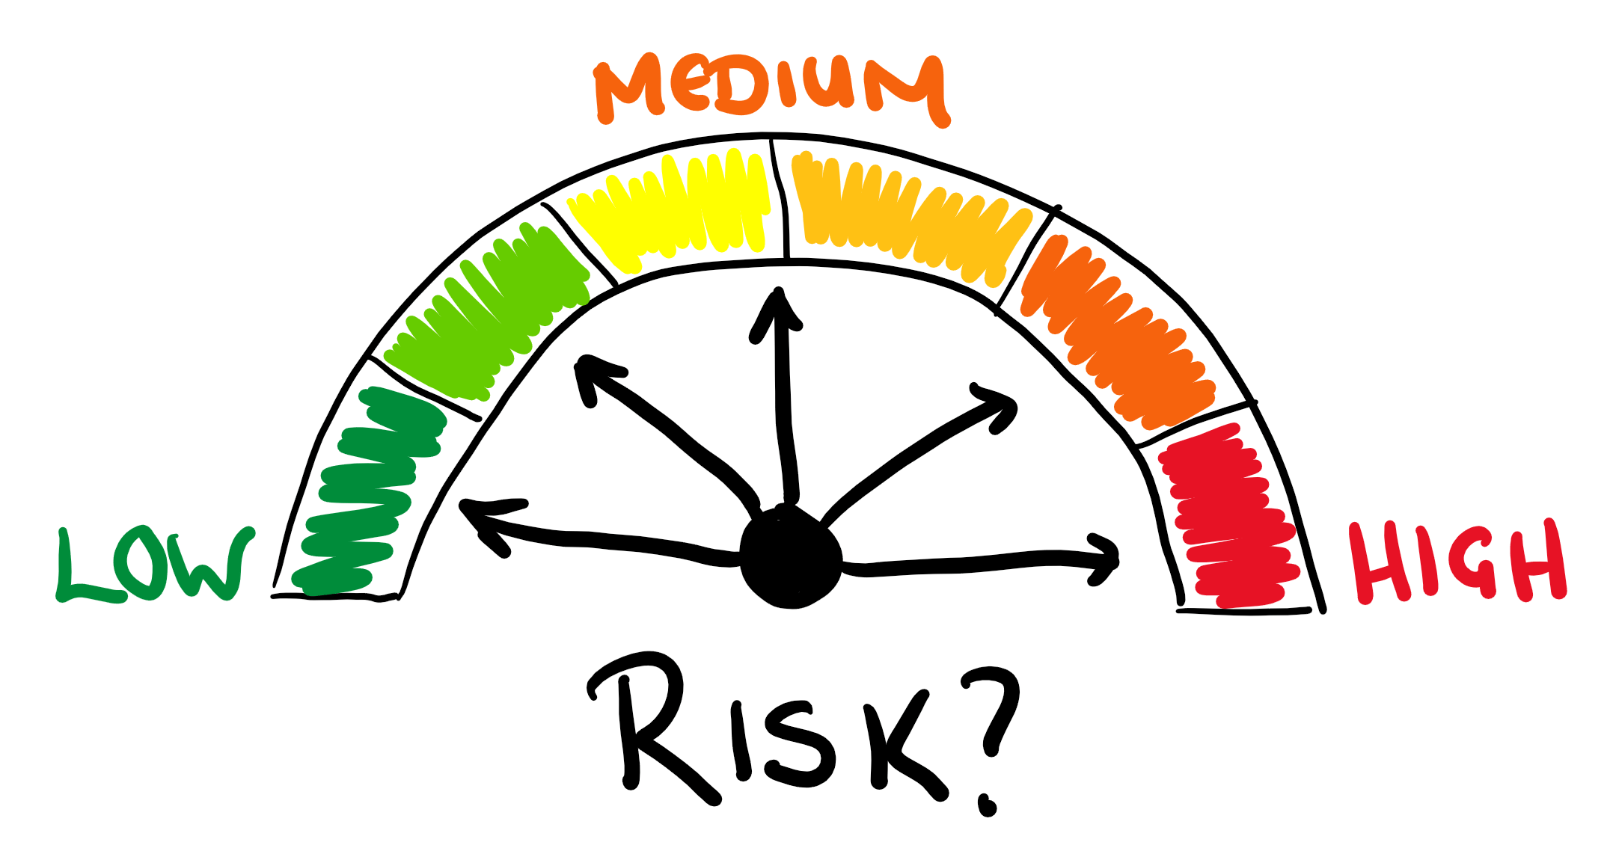
Potential Risks for XYZ Corporation
Data Security Risk
Reputational Risk
Financial Risk
Legal Repercussions

Slide 28

Opportunities for XYZ Corporation
Market Reach:
Improved Security
Competitive Advantage

Slide 29
Preventive Measures for XYZ Corporation to Request from Equifax
Vulnerability Management
Accelerated Patching
Continuous Vulnerability Scanning
Penetration Testing
Bug Bounty Program
Data Security Enhancements
Data Encryption
Strict Access Controls
Data Minimization
Secure Data Handling
Incident Response and Detection
Advanced Intrusion Detection/Prevention Systems (IDS/IPS)
Security Awareness and Training
Comprehensive Logging and Monitoring
Rigorous Incident Response Plans

Slide 30
Preventive Measures for XYZ Corporation to Request from Equifax
Transparency
and Communication
Regular Security Audits and Reports
Prompt Breach Notification
Dedicated Security Liaison
Additional Measures
Red Teaming Exercises
Security Culture

Slide 31
Negotiate Robust Contractual Clauses
Data Security Warranties and Indemnification:
Secure guarantees from Equifax regarding data security and ensure financial protection for XYZ Corporation in case of a breach.
Enhanced Security Controls:
Require implementation of specific security controls at Equifax, such as encryption, access control, and logging, aligned with agreed-upon standards.
Transparency and Communication:
Establish clear communication protocols for Equifax to promptly notify XYZ Corporation of any potential security vulnerabilities or incidents.
Termination Rights:
Secure the right to terminate the partnership if Equifax fails to meet agreed-upon security standards or experiences future breaches impacting XYZ Corporation.

Slide 32
Recommendations for XYZ Corporation
Conduct a Comprehensive Security Audit
Develop a Data Minimization Strategy
Conduct a Reputational Risk Assessment
Financial Risk Assessment

Slide 33
Legal and Regulatory Considerations for XYZ
Data Privacy Laws
Contractual Review
Regulatory Oversight

Slide 34
KEY TAKEAWAY
Partnering with Equifax post-breach requires careful consideration, proactive risk mitigation, and leverage of potential opportunities. By conducting a thorough analysis, implementing robust security measures, negotiating strategic contractual clauses, and ensuring compliance with legal and regulatory requirements, XYZ Corporation can minimize potential risks and maximize the benefits of this partnership. This report serves as a comprehensive guide to navigate this complex landscape and make informed decisions that protect your data, reputation, and financial interests.

Slide 35
DESCISION

Slide 36
THANK YOU

Slide 37
Question & Answer Session

